Slide 1
Generative Artificial Intelligence’s Effect on Energy Consumption
Rashad Brown, Mary Grace Burke,
Deryk Clary, Noah Richwine

Slide 2
Agenda
Motivation
Background
PUDL Data
Google Trends Data
Additional Data
Streamlit Visualizations
Data Analysis
Conclusions
Questions

Slide 3
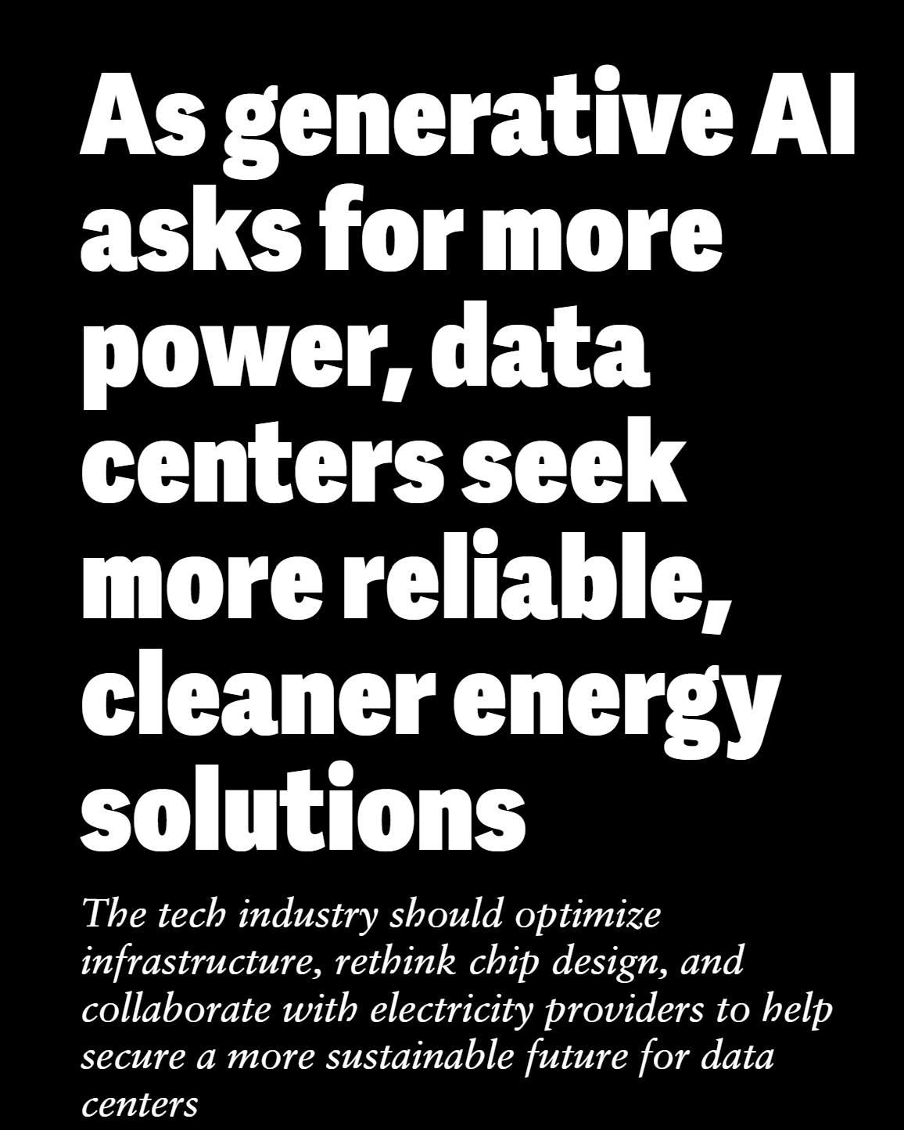
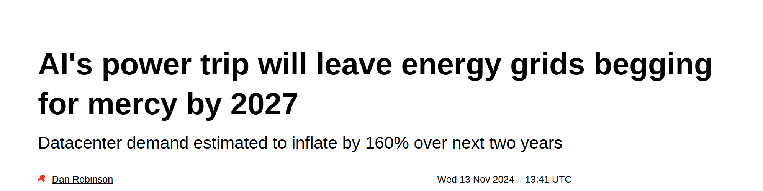
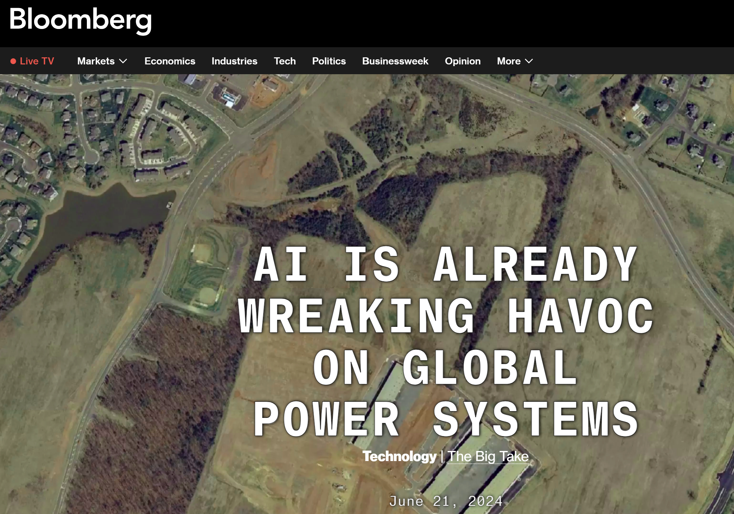
Motivation
" As military officers we need to be thinking about new centers of gravity which can be data centers. " -LT Castillo

Slide 4
Background
Data centers are currently responsible for 2% of global energy consumption, however estimates point to 9% by end of the decade.
A single generative AI prompt consumes 10–100x more electricity than a typical internet search.
If 5% of daily internet searches used generative AI, it would require:
-20,000 servers (8 specialized GPU cores each).
-Servers consuming 6.5 kW each on average.
Total estimated electricity usage:
-3.12 GWh daily / 1.14 TWh annually (equivalent to powering ~108,450 US households annually).
Currently about 3,000 data centers in the United States
Overview of Data Sources:
-PUDL data
-Datasette
-Kaggle
-Google Trends

Slide 5





The Problem
Problem Statement/s
Initial Problem Statement: Is generative AI usage leading to a significant and potentially unsustainable increase in energy consumption globally?
Revised Problem Statement: Is the increase in energy consumption generated from AI usage outpacing green energy production?
Assumptions
Most energy generated is used within state lines
Only considering AI usage in the U.S.
Energy for Generative AI is used at the data centers we identified no matter where the query is from.
Methodology
How do we blend all these datasets to gain insight on impact of generative ai on power consumption.
Most efficient ways to analyze and display data.

Slide 6
PUDL Data
PUDL (Public Utility Data Liberation) is a data processing pipeline created by Catalyst Cooperative that cleans, integrates, and standardizes some of the most widely used public energy datasets in the US.
Very well documented approach and outputs.
Data Sources:
EIA Form 860 – Annual Electric Generator Report
EIA Form 861 – Annual Electric Power Industry Report
EIA Form 923 – Power Plant Operations Report
EPA Hourly Continuous Emission Monitoring System (CEMS)
FERC Form 1 – Annual Report of Major Electric Utilities
FERC Form 714 – Annual Electric Balancing Authority Area and Planning Area Report
Pipelines and Hazardous Materials Safety Administration (PHMSA) Annual Natural Gas Report

Slide 7
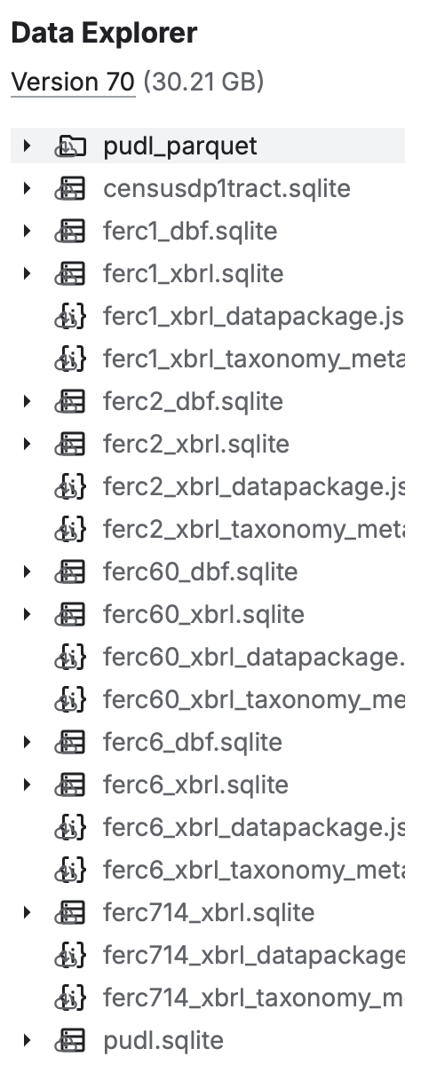
PUDL Data
Results Published On:
Datasette
Kaggle
AWS Open Data Registry
Zenodo
Catalyst Archives
Totals to 30.21 GB.

Slide 8
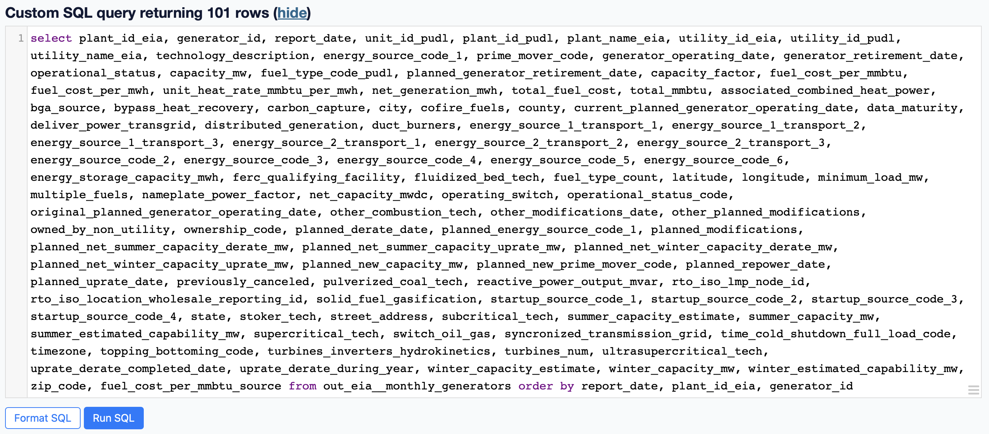
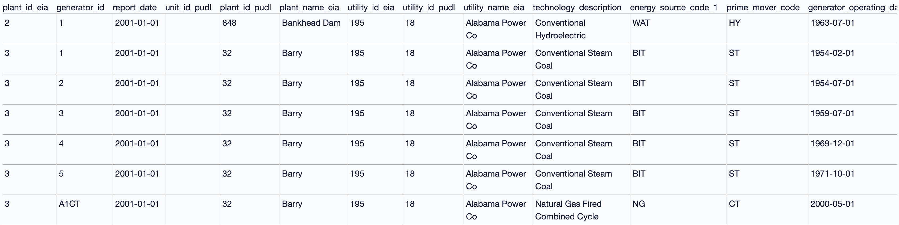
Datasette
Test Query
Preview Results
Datasette allows you to quickly explore lots of data and get a feel of what you need for your project. Each query executes in seconds.

Slide 9
Kaggle API
The Kaggle API and CLI tool provide easy ways to interact with Datasets on Kaggle.
Allows you to search for and download Kaggle Datasets within Python Script / Jupyter Notebook.
Issues:
Unable to query SQL databases saved on Kaggle
Must download datasets as a whole once you find them.
You can create and run Kaggle Notebooks, but unable to find the documentation.

Slide 10
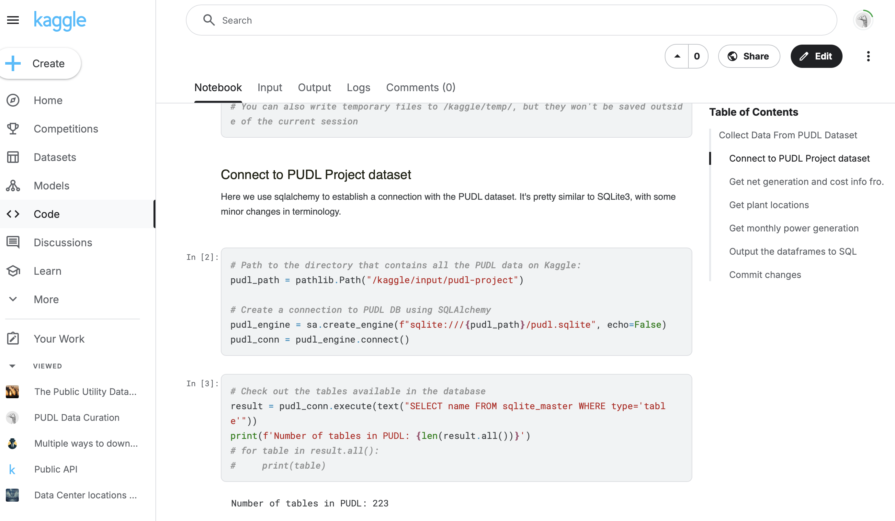
Kaggle Notebook
Using insight from Datasette, you can access just what you need from the dataset using Kaggle’s cloud computing resources.

Slide 11
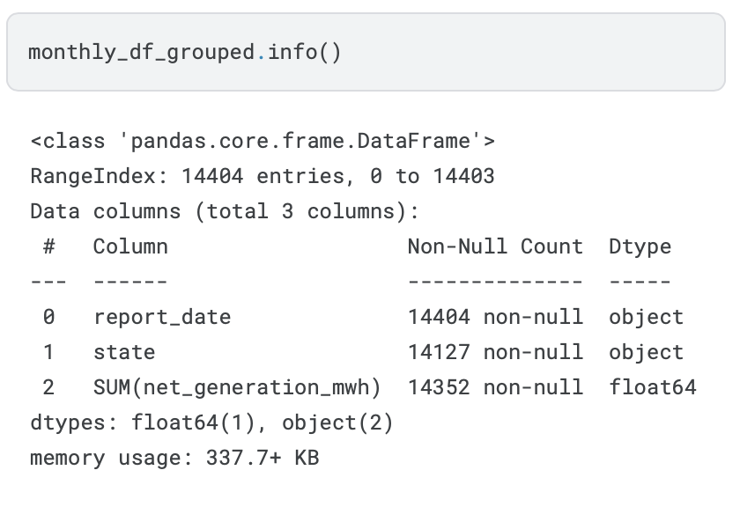
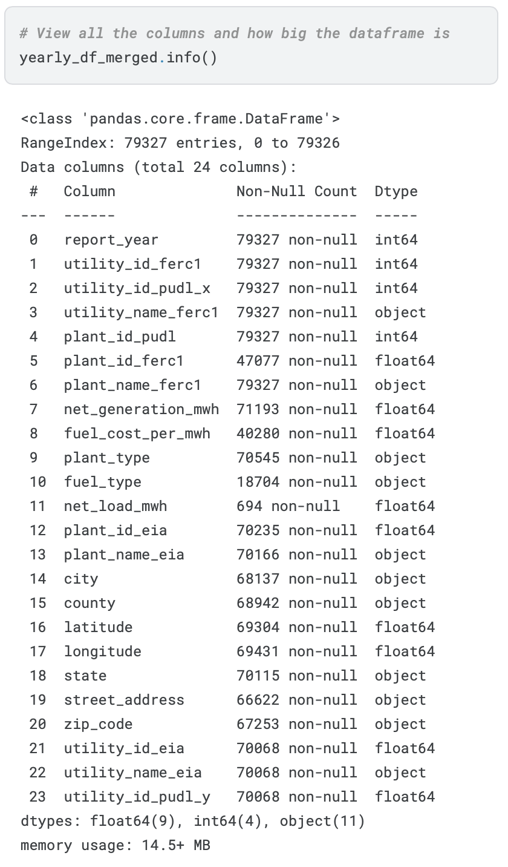
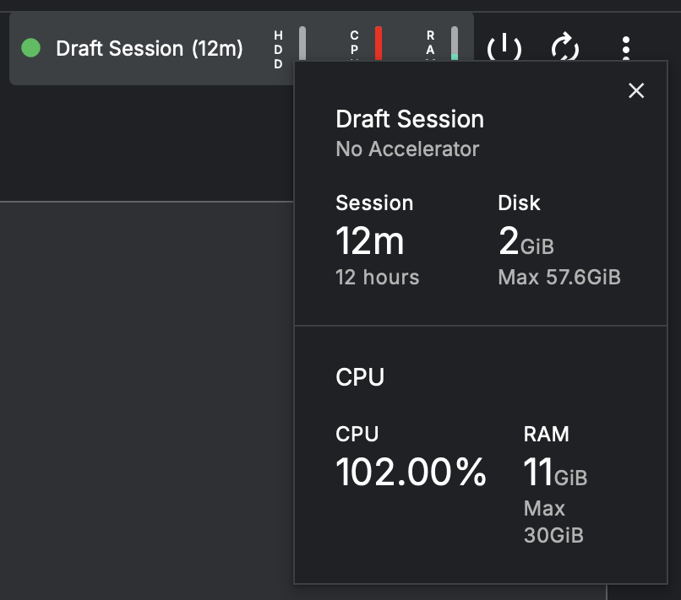
Kaggle Notebook
It still took about 4 minutes to execute three queries, left merge 2 dataframes, and output to a new SQLite database with just a subset of data.

Slide 12
Kaggle Notebook
Pros:
No need to download 30GB worth of data.
Can pre-structure queries on Datasette before executing in Kaggle.
Can add a free GPU/TPU “accelerator” to your environment if needed.
Can open notebooks in Google Cloud Services.
Cons:
Each session is limited to 12 hours and will end (without save) if you are idle for 20 minutes.
May need to wait in a queue to access an accelerator based on resource demand.
Can be buggy when attempting Keyboard Interrupt.

Slide 13
Kaggle Notebook
Data Acquired
Yearly power generation by plant in the United States with locations (2001-2023)
Monthly net power generation by state (2001-2023)
Output to SQLite database, uploaded to GitHub Repo for analysis by group.

Slide 14
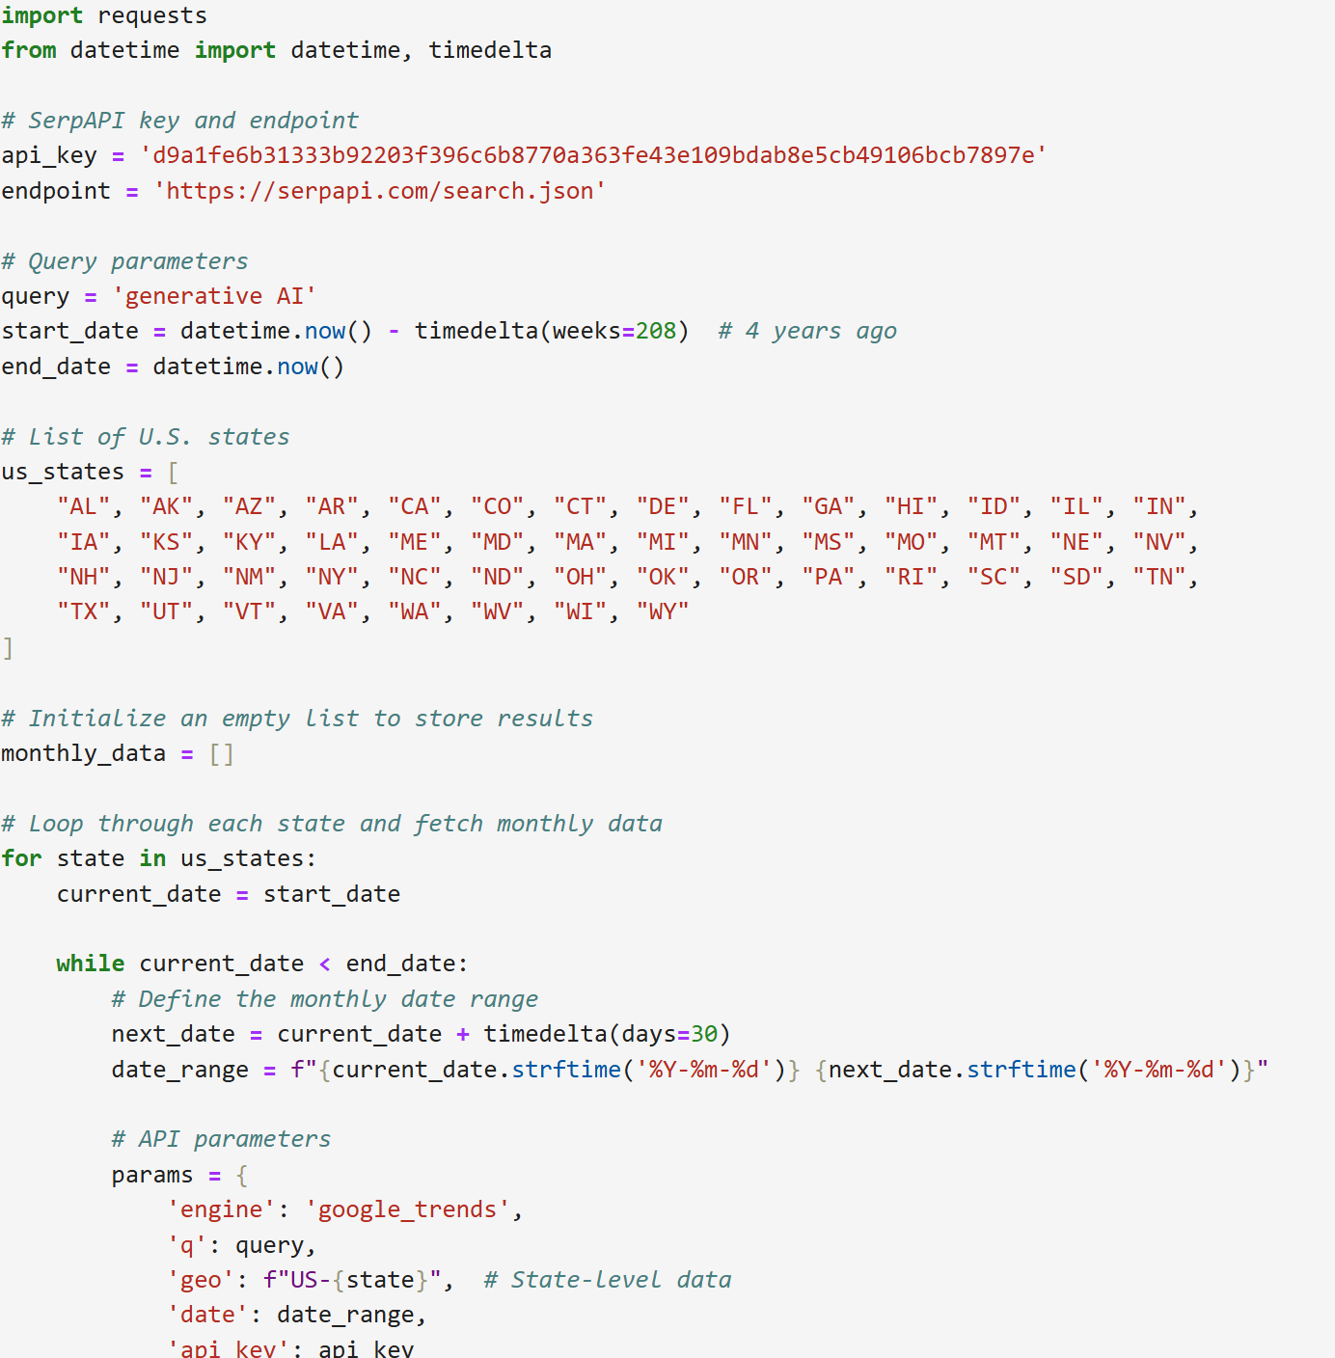
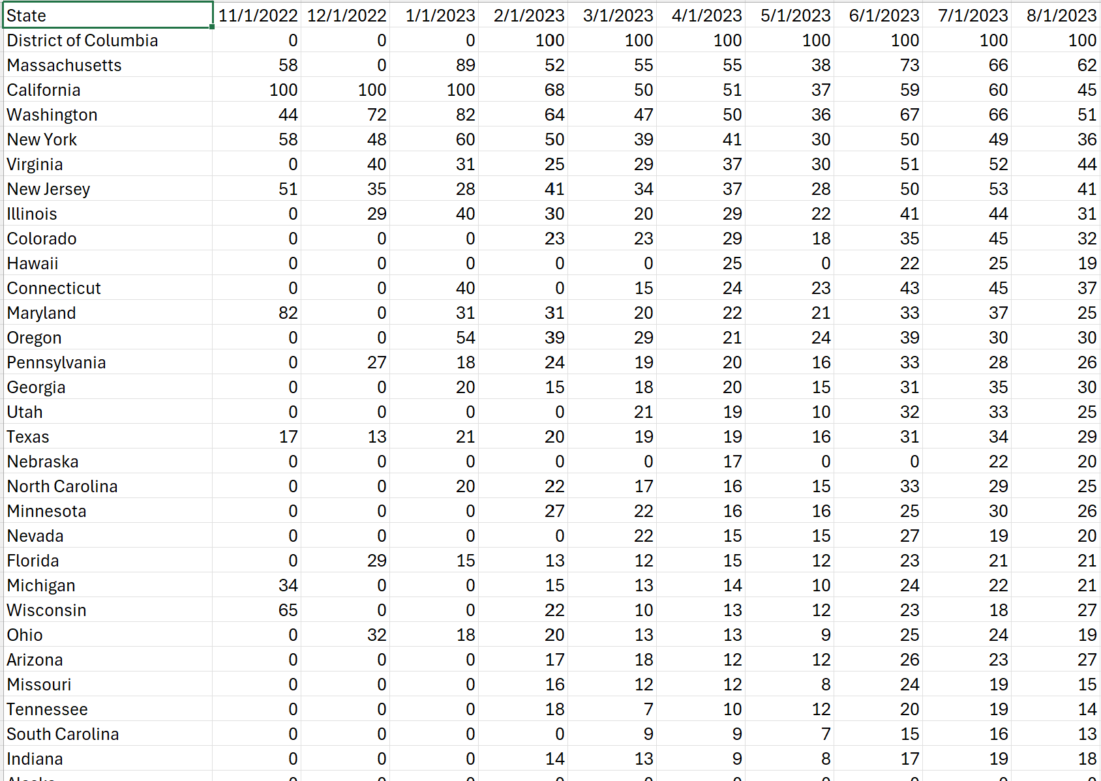
Google Trends Data
Data Collection Method:
Initial Approach:
Used a SerpAPI key to retrieve data programmatically.
Retrieved interest by state, month, and relative score.
Challenges:
API Limitations: Only 100 calls allowed, leading to exhausted quota.
Switched to manual export of monthly CSV files, merging them into a single dataset.
Additional Dataset:
Included a CSV file with national-level interest by week over a 4-year period.
Limitations:
Relative Scale: Data shows relative interest, not the actual volume of queries.
API Costs: SerpAPI has a high cost.

Slide 15









Additional Data Used
US State and Territory Latitude and Longitude Data (Kaggle)
.csv file containing latitude and longitude for each state
Data Center Locations of Top Tech Companies (Kaggle)
Separate .csv files for each company
Continent
Location (City or City, State if in the United States)
Country
Latitude
Longitude
Year Established (blank for all entries)

Slide 16
Streamlit Visualizations
Utilized Streamlit and Folium maps to create interactive visualizations for initial data exploration.
Data Cleaning Process
Removed data points with missing latitudes and longitudes
Grouped similar power plant types to simplify analysis
Two Applications:
1. Map displaying data centers and power plants in the United States
Data centers are categorized by company (Apple, Google, Meta, IBM, Microsoft, etc.)
Power plants are categorized by type (Nuclear, Fossil Fuels, Solar, Hydro, Steam, etc.)
Toggle feature to add/remove layers, colors, and size from the map
Year selection feature to view power generation from a specific year
2. Heat map showing trends in interest for generative AI over time

Slide 17
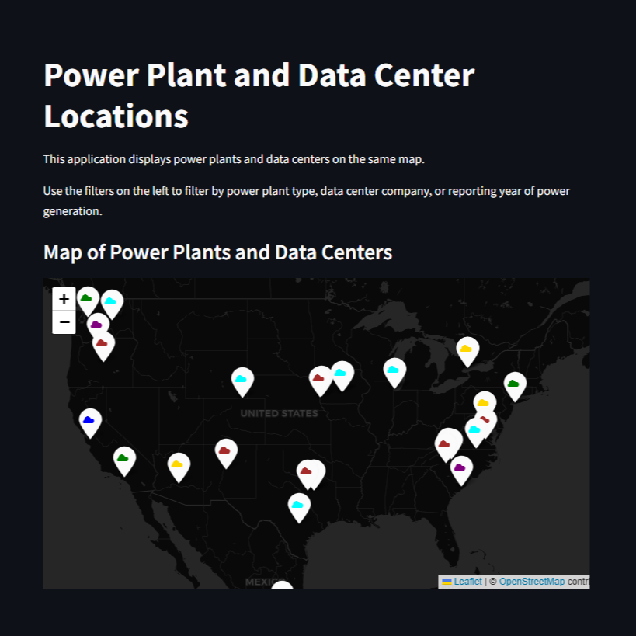
Power Plant and Data Center Streamlit

Slide 18
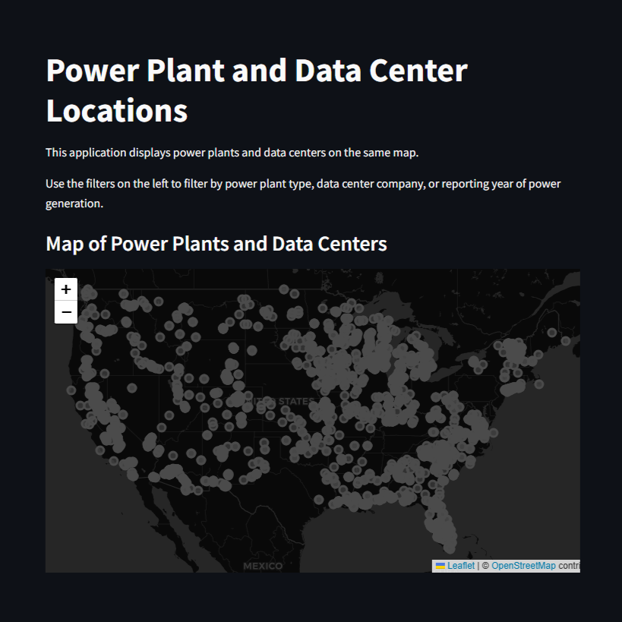
Power Plant and Data Center Streamlit

Slide 19
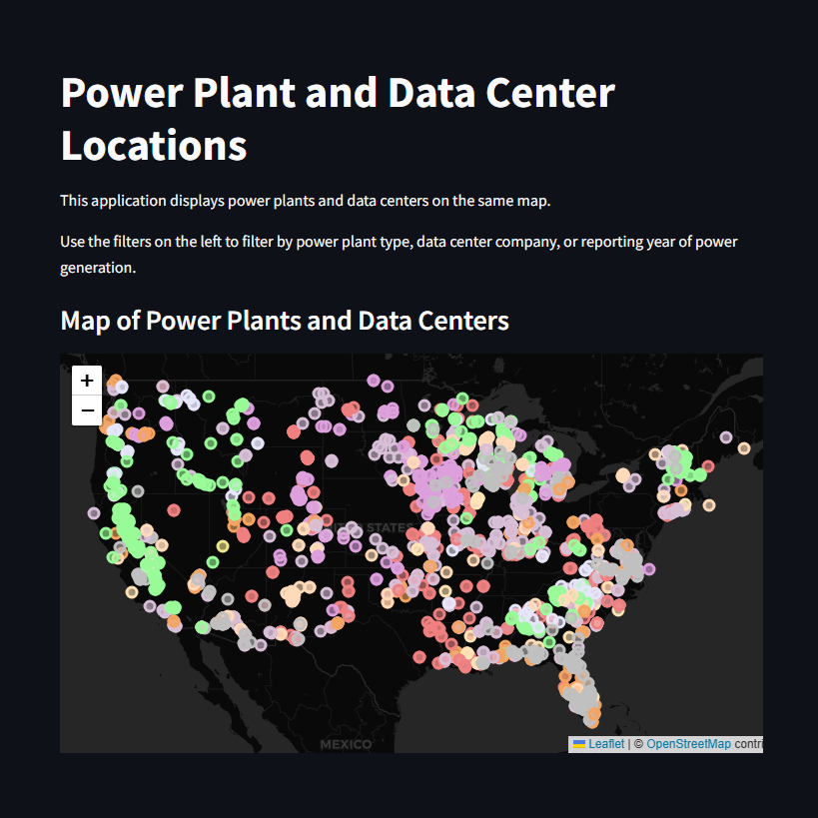
Power Plant and Data Center Streamlit

Slide 20
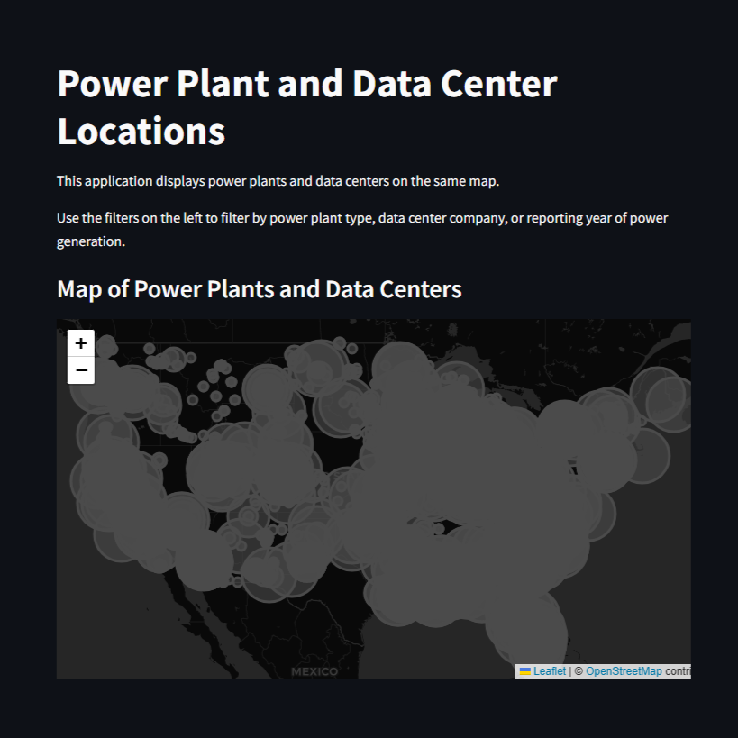
Power Plant and Data Center Streamlit

Slide 21
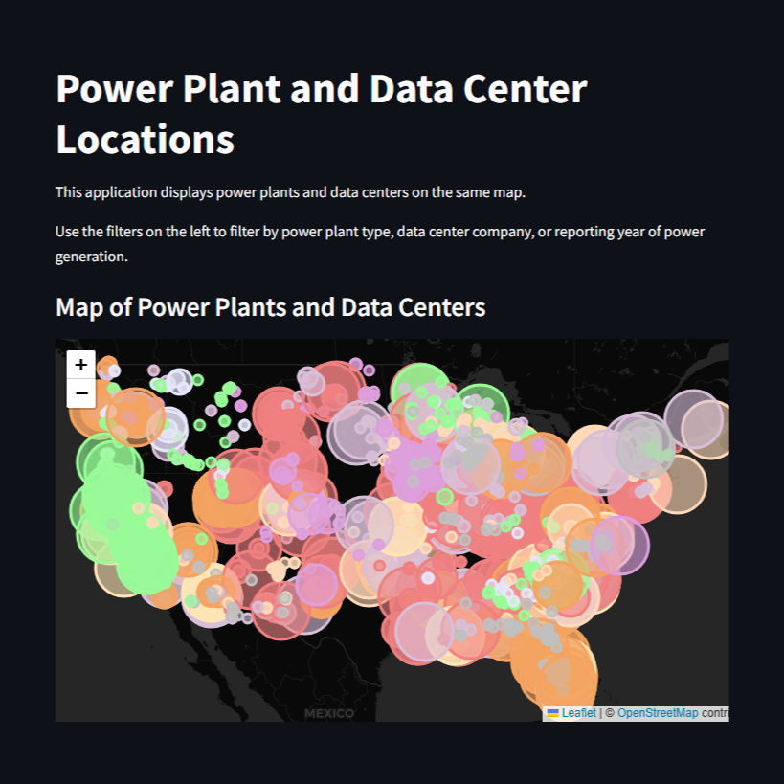
Power Plant and Data Center Streamlit

Slide 22
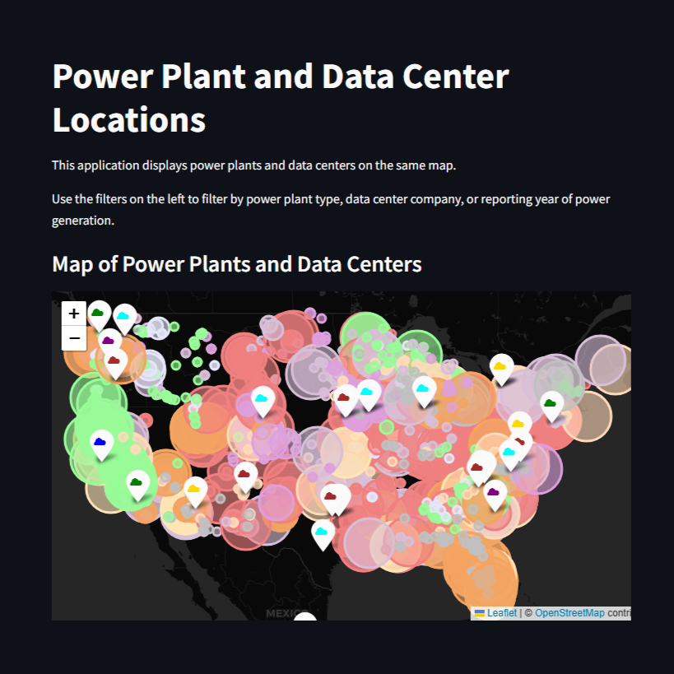
Power Plant and Data Center Streamlit

Slide 23
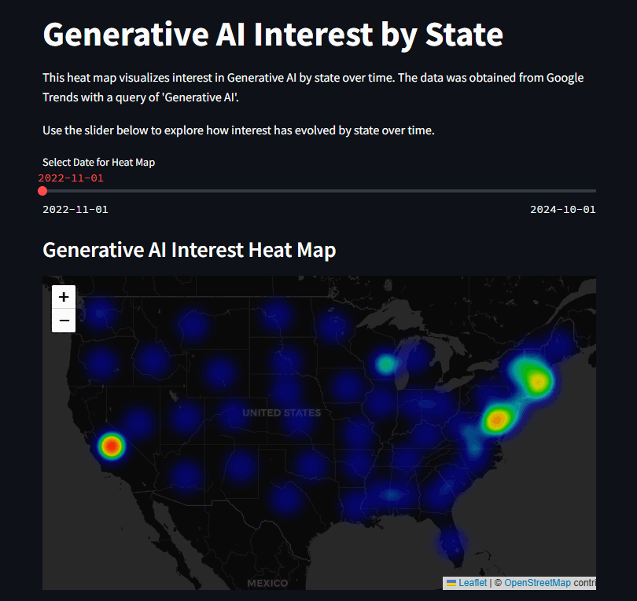
Google Trends: Generative AI by State

Slide 24
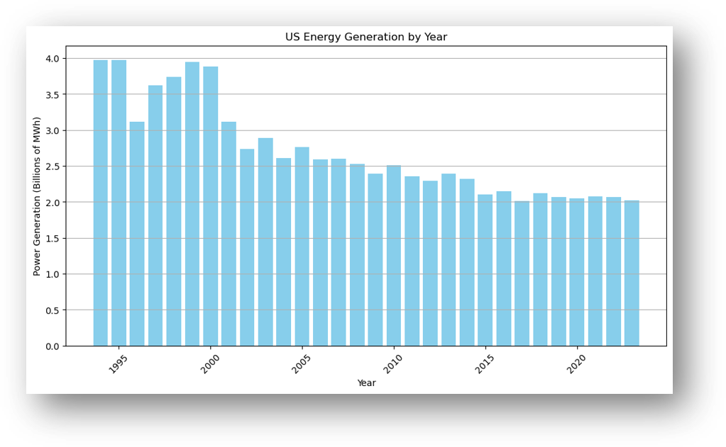
Let's Plot Some Data
"In the US, power demand is expected to grow by 40% over the next two decades"
-AI’s Insatiable Need for Energy Is Straining Global Power Grids

Slide 25
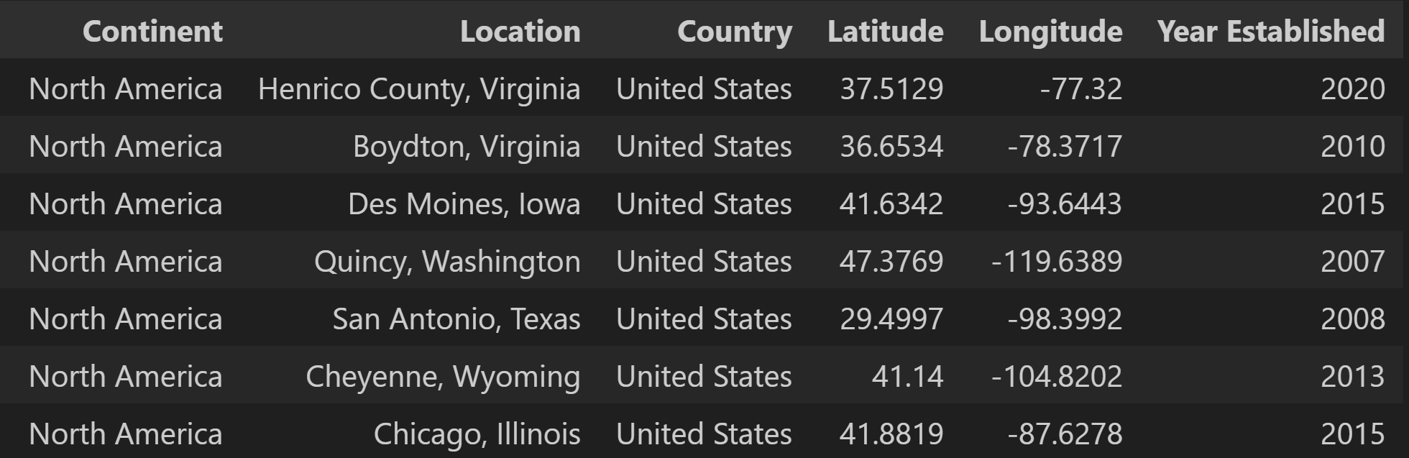

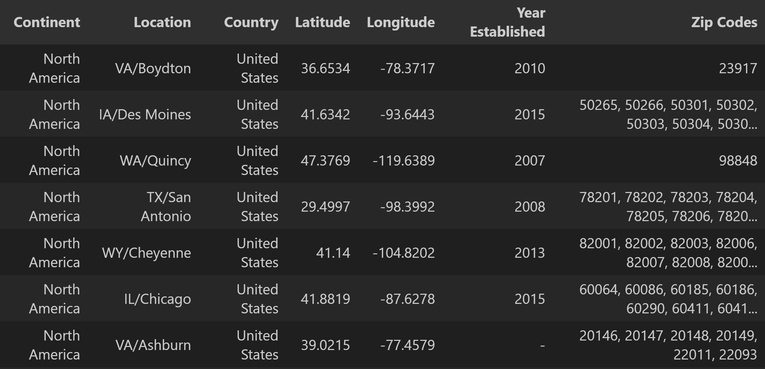
Working with Datacenter Locations
Zippopotomus API used to retrieve ZIP Code data for all datacenters of interest

Slide 26
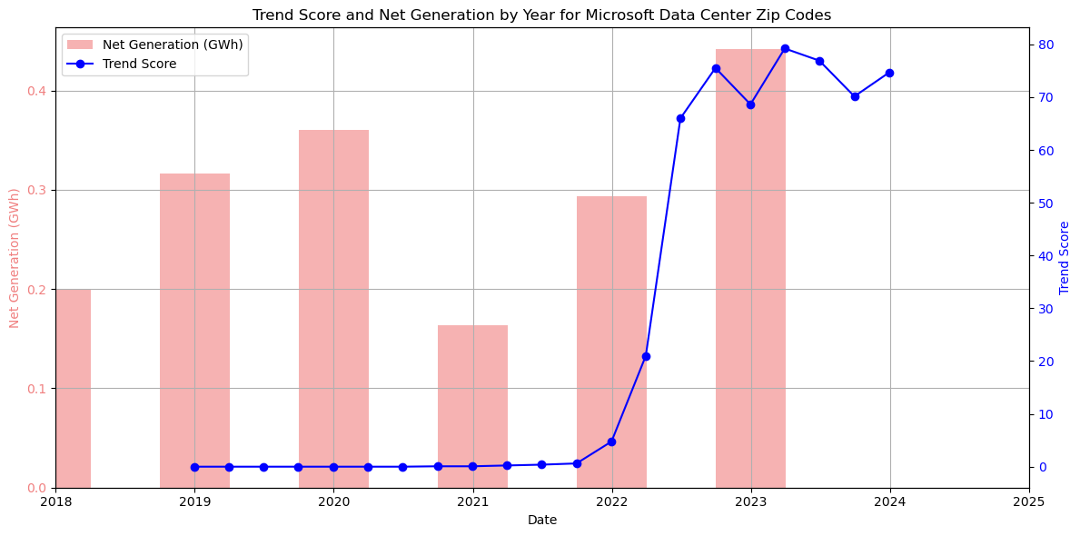
An Attempt
Is generative AI usage leading to a significant and potentially unsustainable increase in energy consumption?

Slide 27
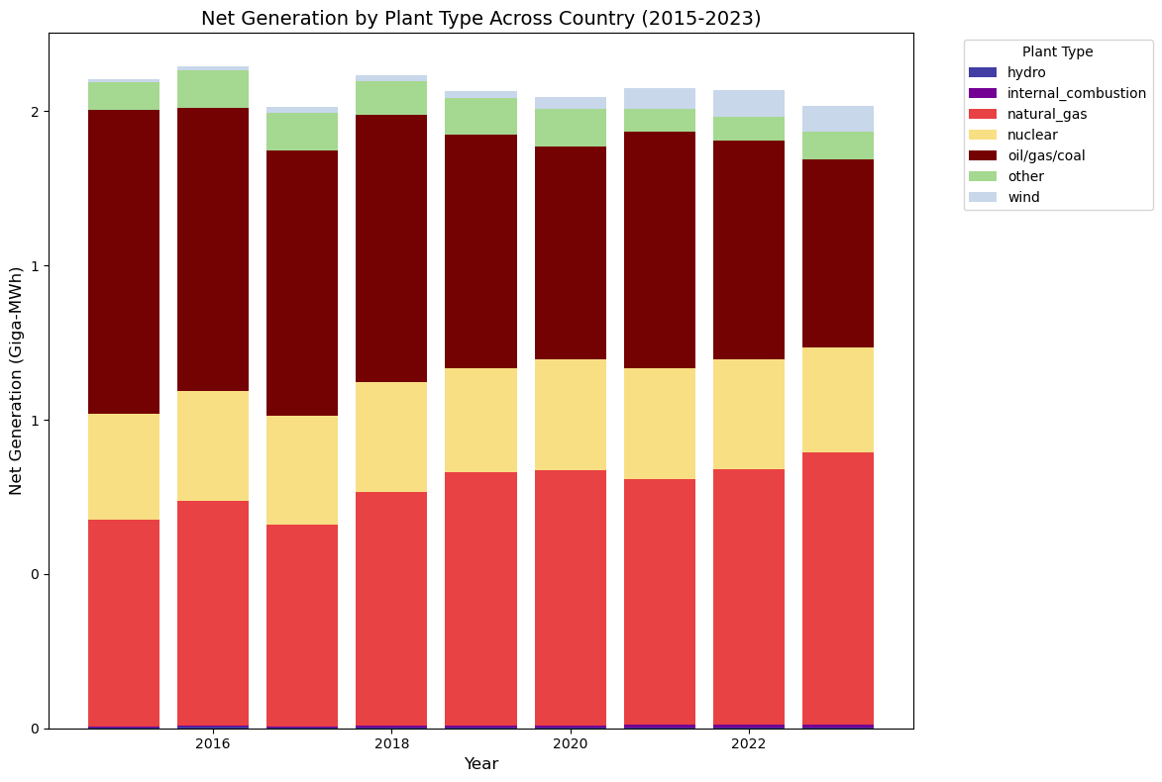
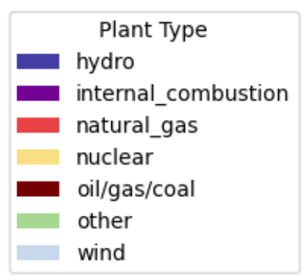
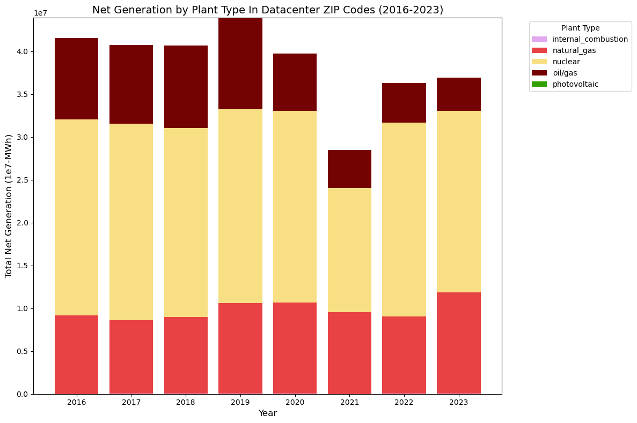
Country vs. Datacenter ZIP Codes
Is the increase in energy consumption generated from AI usage outpacing green energy production?
General Energy
vs.
Datacenter Energy

Slide 28


How Much Energy Does a Datacenter Consume?
Microsoft's Data Center in Quincy, WA uses ~50MW of Power*
In 2024, the number of hyperscale datacenters like the one above reached 1,000
*https://www.microsoft.com/en-us/sustainability/energy
Convenient Math
~2e7 MWh Produced Annually
Near Datacenters
Enough Power for ~46 Hyperscale Datacenters

Slide 29
What Gives? I Have 1000 Datacenters
Assumptions in Quantitative Analysis:
Energy produced = Energy Consumed
Added Energy Load = Data Center Energy
Recent predictions show data centers may make up 30-40% of new power demand through 2030*
Direct correlation between "Generative AI" Google Queries and ChatGPT Queries
Powerplant Generation takes place in same Zip code as datacenter
Conclusions From Qualitative Analysis:
Datacenter energy comes from a much larger proportion of green sources than other energy demands in the US
Free data sources are mostly insufficient for quantitative datacenter power consumption and powerplant generation analysis
There is an obvious increase in energy consumption by datacenters. It is important for companies to continue to strive to meet energy demands through 'green' means
*https://www.mckinsey.com/industries/private-capital/our-insights/how-data-centers-and-the-energy-sector-can-sate-ais-hunger-for-power

Slide 30
Future Work
Utilize paid data sources such as Bloomberg NEF or DC Byte to conduct in-depth analysis
Address assumptions used in this analysis:
Include additional Google queries
Research where specific datacenters get their power
Account for datacenters making a portion of demand increase
Research the dip in datacenter power seen in 2021
Explore other means of geographic correlation such as County vs. Zip Code

Slide 31





Questions?

Slide 32
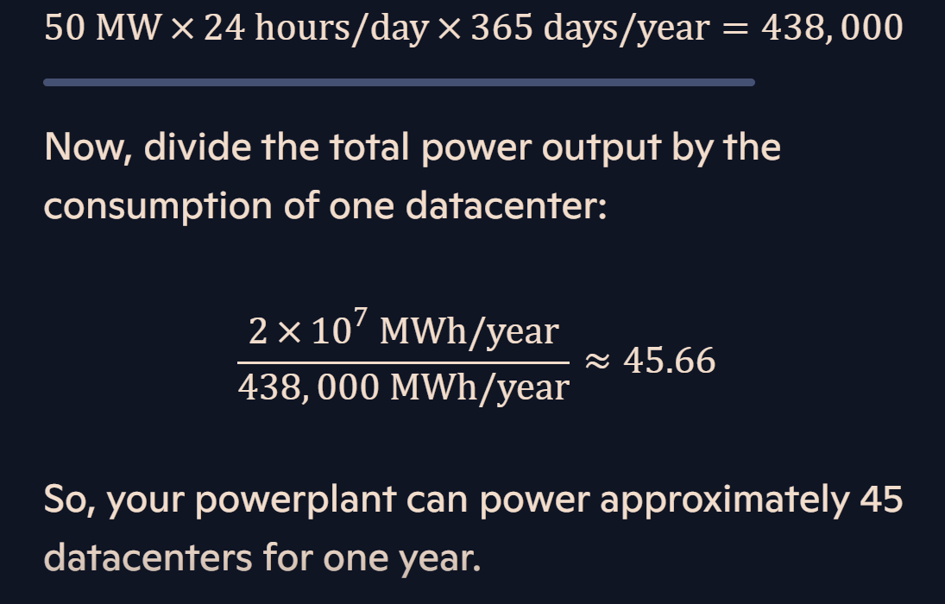
Convenient Math
Thanks, Copilot

